Slide 1

Attrition Measurement
Update Year End 2013
Developing Meaningful
Trends
Prepared By:
TRG Associates, Inc.
860-395-0548
www.trgassociates.com

Slide 2
Defining Attrition
Gross Attrition
  The loss of existing customers and their associated recurring monthly revenue (RMR) for contracted services during a particular customer / calendar cycle
Net Attrition
  Gross Attrition plus the add back of “like customer” gains thru resigns of the existing locations –
    - The Home/Business location is your ultimate customer
    - Price increases for inflation
    - Price increases for additional services or technology

Slide 3
Defining Attrition
The Short Version
  The measurement of customer dissatisfaction with or need for the system
Why Measure?
  Attrition measures customer dissatisfaction which, for the most part, is company caused.
  The Attrition Tracking Process should be managed to identify, focus on, and rectify those causes within each organization.

Slide 4
Attrition Measurement Methodology
Weighted Ending RMR Attrition Method
Step 1: Cancelled RMR for the Reporting Period = Monthly Attrition
Sum of Ending RMR for Each Month
Step 2: Monthly Attrition (from Step 1)* 12 = Annualized Attrition
An Excel Attrition Measurement Template is available on
the TRG website with calculation formulas

Slide 5
Benefits of Weighted Ending RMR Method
Accounts for and weights RMR acquisitions
Accounts for timing of acquired RMR
Accounts for rapid internal growth and the timing thereof
Similar to many lending/equity institution’s preferred calculation.

Slide 6
The Geography of Attrition
NE/Mid Atlantic
Southeast
Midwest
Southwest
West
International

Slide 7
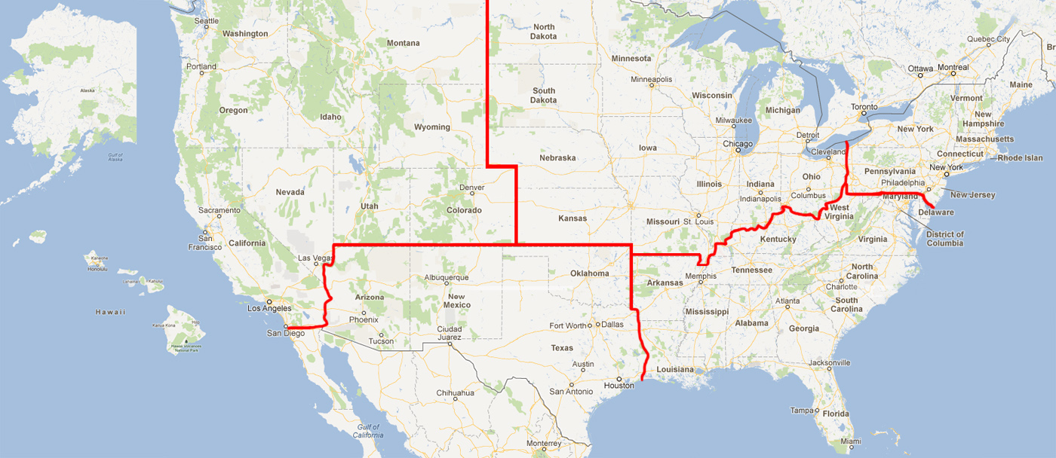

Slide 8
Annual Trend
Dollars of RMR*
Region |  | 2011 |  | 2012 |  | 2013
Northeast | $ | 38,123,162 | $ | 48,920,548 | $ | 52,311,055
Southeast | $ | 42,678,957 | $ | 56,796,490 | $ | 57,159,860
Midwest | $ | 32,755,145 | $ | 48,737,682 | $ | 54,399,311
Southwest | $ | 20,315,471 | $ | 32,626,153 | $ | 36,954,898
West | $ | 39,705,534 | $ | 51,831,211 | $ | 61,370,622
International | $ | 5,035,296 | $ | 25,051,727 | $ | 27,166,200
 | $ | 178,613,564 | $ | 263,963,811 | $ | 289,361,946
*Recurring Monthly Revenue

Slide 9
Annual Trend
Dollars of RMR*
Size |  | 2011 |  | 2012 |  | 2013
3-50 | $ | 291,596 | $ | 316,903 | $ | 275,858
51-100 | $ | 659,794 | $ | 912,243 | $ | 530,285
101-200 | $ | 2,578,119 | $ | 1,492,158 | $ | 1,264,797
201-500 | $ | 17,103,573 | $ | 15,310,870 | $ | 16,002,718
500+ | $ | 157,980,482 | $ | 245,931,637 | $ | 271,288,288
Total | $ | 178,613,564 | $ | 263,963,811 | $ | 289,361,946
*Includes branches of companies reflected by RMR size/Attrition if provided

Slide 10
Annual Trend
Dollars of RMR
Customer Source |  | 2011 |  | 2012 |  | 2013
Dealer | $ | 49,127,653 | $ | 59,241,988 | $ | 66,836,266
Traditional | $ | 85,279,682 | $ | 131,256,462 | $ | 134,049,625
Mass Market | $ | 44,206,230 | $ | 73,465,362 | $ | 88,476,054
Total | $ | 178,613,564 | $ | 263,963,811 | $ | 289,361,946

Slide 11
Annual Trend
Dollars of RMR
Customer Type |  | 2011 |  | 2012 |  | 2013
Residential | $ | 101,339,459 | $ | 148,016,396 | $ | 164,326,198
Commercial | $ | 77,274,105 | $ | 115,947,415 | $ | 125,035,748
Total | $ | 178,613,564 | $ | 263,963,811 | $ | 289,361,946

Slide 12
Attrition Update through Year End 2013
 | 2011 |  | 2012 |  | 2013
Region | Gross | Net | Gross | Net | Gross | Net
Northeast | 10.34% | 7.94% | 10.69% | 8.42% | 11.09% | 9.10%
Southeast | 11.63% | 9.47% | 11.47% | 9.24% | 12.44% | 10.52%
Midwest | 10.92% | 9.23% | 11.64% | 9.70% | 12.26% | 10.64%
Southwest | 11.98% | 10.06% | 12.13% | 10.09% | 13.50% | 11.89%
West | 11.43% | 9.16% | 11.43% | 9.06% | 12.26% | 10.14%
International | 10.76% | 9.42% | 12.22% | 9.85% | 12.61% | 10.55%

Slide 13
Attrition Update through Year End 2013
 | 2011 |  | 2012 |  | 2013
Co. Size | Gross | Net | Gross | Net | Gross | Net
3-50 | 7.26% | 4.80% | 5.63% | 3.54% | 6.82% | 5.53%
51-100 | 9.69% | 6.68% | 8.41% | 5.92% | 5.96% | 3.73%
101-200 | 9.30% | 7.10% | 9.64% | 7.58% | 9.65% | 8.00%
201-500 | 9.46% | 7.83% | 8.77% | 6.63% | 9.27% | 7.73%
500+ | 11.43% | 9.02% | 11.70% | 9.50% | 12.48% | 10.57%

Slide 14
Attrition Update through Year End 2013
 | 2011 |  | 2012 |  | 2013
Source | Gross | Net | Gross | Net | Gross | Net
Dealer | 12.36% | 9.91% | 12.08% | 9.85% | 12.64% | 10.96%
Traditional | 10.70% | 8.60% | 11.56% | 9.40% | 11.84% | 9.86%
Mass Market | 10.84% | 9.14% | 10.92% | 8.69% | 12.67% | 10.74%

Slide 15
Attrition Update through Year End 2013
 | 2011 |  | 2012 |  | 2013
Customer Type | Gross | Net | Gross | Net | Gross | Net
Residential | 11.26% | 9.17% | 11.29% | 8.99% | 12.43% | 10.51%
Commercial | 11.10% | 9.00% | 11.78% | 9.69% | 12.07% | 10.22%

Slide 16
Impact on Attrition Measurement with TWO Largest Company Results (TLC)
 | Excluding TLC |  | Including TLC
 | 2012 | 2013 | 2012 | 2013
501+ RMR Companies | $245.9M | $271.3 | $569.2M | $587.2M
Net Attrition
Company Size | 9.50% | 10.57% | 11.66% | 12.53%
Residential | 8.99% | 10.51% | 12.02% | 12.82%
Commercial | 9.69% | 10.22% | 10.38% | 11.68%
Sources: SDM May 2014 – SDM 100
SEC Filings 10K
Public Quarterly Company Reviews

Slide 17
Top Reasons for Attrition

Slide 18
Reason Code Analysis
Cancellation Reason | 2010 | 2011 | 2012 | 2013
Collection/Non Payment | 21.6% | 19.1% | 18.6% | 16.1%
Moved | 31.3% | 33.9% | 37.0% | 35.6%
Poor Service | 7.7% | 2.0% | 2.8% | 3.3%
Lost to Competition | 7.9% | 13.5% | 11.4% | 14.3%
No Longer Using System | 9.4% | 7.6% | 11.6% | 10.4%
Sold/Out of Business | 6.3% | 6.8% | 5.2% | 3.1%
Financial Difficulties | 9.3% | 6.2% | 6.3% | 9.3%
Property Abandoned/Vacant | 0.2% | 0.3% | 0.2% | 0.1%
End of Contract Term | 0.4% | 0.8% | 1.2% | 0.7%
Deceased/Rest home | 1.2% | 0.7% | 1.2% | 0.5%
PI Rescinded/RMR Reduction | 4.7% | 9.1% | 4.5% | 6.6%
Natural Disaster/Military | 0.0% | 0.0% | 0.0% | 0.0%

Slide 19
TRG Maintains Full Confidentiality of Participant’s Figures
Summary results as presented will be available on
CSAA Web-Site (www.csaaintl.org)
TRG Web-Site (www.trgassociates.com)
Next update for 2014 – May 2015
Posted in June 2015

