Slide 1
Attrition Measurement
Update 2018
Continuing to Develop Meaningful Trends
Prepared By:
TRG Associates, Inc.
860-395-0548
www.trgassociates.com

Slide 2

Due Diligence
Acquisition Planning
Seeking Debt & Equity
Operations Analysis
Business Valuations
Expert Witness
Customer Surveys
Social Media Assessment

Slide 3
Defining Attrition
Gross Attrition
  The loss of existing customers and their associated recurring monthly revenue (RMR) for contracted services during a particular customer/ calendar cycle
Net Attrition
  Gross Attrition plus the add back of “like customer” gains thru resigns of the existing locations –
    - The Home/Business location is your ultimate customer
    - Price increases for inflation
    - Price increases for additional services or technology

Slide 4
Defining Attrition
The Short Version
  The measurement of customer dissatisfaction with or need for the system
Why Measure?
  Attrition measures customer dissatisfaction which, for the most part, is company caused.
  The Attrition Tracking Process should be managed to identify, focus on, and rectify those causes within each organization.

Slide 5
Attrition Measurement Methodology
Weighted Ending RMR Attrition Method
Step 1: Cancelled RMR for the Reporting Period = Monthly Attrition Sum of Ending RMR for Each Month
Step 2: Monthly Attrition (from Step 1)* 12 = Annualized Attrition
An Excel Attrition Measurement Template is available on
the TRG website with calculation formulas

Slide 6
Benefits of Weighted Ending RMR Method
Accounts for and weights RMR acquisitions
Accounts for timing of acquired RMR
Accounts for rapid internal growth and the timing thereof
Similar to many lending/equity institution’s preferred calculation.

Slide 7
The Geography of Attrition
NE/Mid Atlantic
Southeast
Midwest
Southwest
West
International

Slide 8
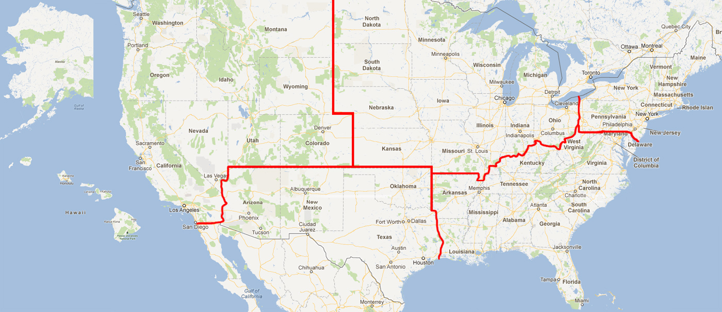

Slide 9
Annual Trend Dollars of RMR*
Region |  | 2016 |  | 2017 |  | 2018
Northeast | $ | 57,297,528 | $ | 61,334,025 | $ | 61,733,809
Southeast | $ | 71,595,895 | $ | 78,092,485 | $ | 83,800,371
Midwest | $ | 58,074,794 | $ | 62,794,424 | $ | 66,113,540
Southwest | $ | 46,047,519 | $ | 52,275,939 | $ | 57,191,449
West | $ | 70,346,795 | $ | 77,141,809 | $ | 79,871,416
International | $ | 28,284,374 | $ | 34,481,330 | $ | 32,481,077
 | $ | 331,646,905 | $ | 366,120,011 | $ | 381,191,662
*Recurring Monthly Revenue

Slide 10
Annual Trend Dollars of RMR*
Size |  | 2016 |  | 2017 |  | 2018
3-50 | $ | 160,224 | $ | 255,041 | $ | 302,197
51-100 | $ | 830,403 | $ | 1,127,048 | $ | 985,066
101-200 | $ | 2,099,217 | $ | 2,406,738 | $ | 1,889,849
201-500 | $ | 15,873,539 | $ | 16,489,623 | $ | 16,968,853
500+ | $ | 312,683,522 | $ | 345,841,561 | $ | 361,045,697
Total | $ | 331,646,905 | $ | 366,120,011 | $ | 381,191,662
*Includes branches of companies reflected by RMR size/Attrition if provided

Slide 11
Annual Trend Dollars of RMR
Customer Source |  | 2016 |  | 2017 |  | 2018
Dealer | $ | 67,500,074 | $ | 63,001,159 | $ | 65,650,799
Traditional | $ | 145,013,567 | $ | 159,469,080 | $ | 162,909,974
Mass Market | $ | 119,133,264 | $ | 143,649,772 | $ | 152,630,889
Total | $ | 331,646,905 | $ | 366,120,011 | $ | 381,191,662

Slide 12
Annual Trend Dollars of RMR
Customer Type |  | 2016 |  | 2017 |  | 2018
Residential | $ | 200,515,508 | $ | 218,645,015 | $ | 230,316,551
Commercial | $ | 131,131,397 | $ | 147,474,997 | $ | 150,875,111
Total | $ | 331,646,905 | $ | 366,120,011 | $ | 381,191,662

Slide 13
Attrition Update through Year End 2018
 | 2016 |  | 2017 |  | 2018
Region | Gross | Net | Gross | Net | Gross | Net
Northeast | 12.19% | 10.43% | 12.46% | 10.41% | 13.08% | 11.00%
Southeast | 12.91% | 10.92% | 13.21% | 10.61% | 13.54% | 11.29%
Midwest | 12.29% | 10.70% | 12.61% | 10.32% | 12.88% | 10.86%
Southwest | 14.39% | 12.65% | 14.64% | 12.32% | 14.79% | 12.85%
West | 12.64% | 10.39% | 13.16% | 10.53% | 13.43% | 10.99%
International | 13.90% | 12.18% | 13.55% | 11.31% | 13.86% | 11.91%

Slide 14
Attrition Update through Year End 2018
 | 2016 |  | 2017 |  | 2018
Co. Size | Gross | Net | Gross | Net | Gross | Net
3-50 | 8.32% | 7.64% | 7.67% | 6.30% | 8.18% | 6.65%
51-100 | 9.43% | 7.44% | 9.00% | 7.10% | 9.40% | 7.52%
101-200 | 9.18% | 7.90% | 8.71% | 7.46% | 10.24% | 8.55%
201-500 | 10.66% | 8.93% | 10.48% | 8.74% | 10.66% | 8.93%
500+ | 13.06% | 11.17% | 13.39% | 10.96% | 13.71% | 11.54%

Slide 15
Net Attrition by Company Size
10 Year Profile

Slide 16
Attrition Update through Year End 2018
 | 2016 |  | 2017 |  | 2018
Source | Gross | Net | Gross | Net | Gross | Net
Dealer | 12.99% | 11.66% | 14.37% | 12.54% | 16.06% | 13.95%
Traditional | 11.96% | 9.96% | 12.17% | 9.99% | 12.03% | 9.68%
Mass Market | 14.01% | 11.98% | 13.84% | 10.99% | 14.07% | 12.12%

Slide 17
Net Attrition by Origination Source
10 Year Profile

Slide 18
Attrition Update through Year End 2018
 | 2016 |  | 2017 |  | 2018
Customer Type | Gross | Net | Gross | Net | Gross | Net
Residential | 13.40% | 11.50% | 13.73% | 11.13% | 14.21% | 12.14%
Commercial | 12.15% | 10.32% | 12.43% | 10.36% | 12.52% | 10.25%

Slide 19
Residential vs. Commercial 10 Year Profile

Slide 20
Impact on Attrition Measurement with
TWO Largest Company Results (TLC)
 | Excluding TLC |  | Including TLC
 | 2017 | 2018 | 2017 | 2018
501+ RMR Companies | 345.8$M | $361.2M | $788.7M | $779.1M
Net Attrition
Company Size | 10.96% | 11.54% | 12.33% | 12.35%
Residential | 11.13% | 12.14% | 12.68% | 12.74%
Commercial | 10.36% | 10.25% | 11.26% | 11.55%
Sources: SDM May 2019 – SDM 100
SEC Filings 10K
Public Quarterly Company Review
Research Company Data

Slide 21
Net Attrition Inclusive of TLC

Slide 22
Top Reasons for Attrition

Slide 23
Reason Code Analysis
Cancellation Reason | 2015 | 2016 | 2017 | 2018
Collection/Non-Payment | 15.1% | 14.8% | 11.6% | 11.1%
Moved | 33.6% | 32.5% | 34.1% | 33.8%
Poor Service | 3.4% | 3.3% | 2.5% | 3.3%
Lost to Competition | 16.0% | 14.9% | 12.9% | 13.4%
No Longer Using System | 10.8% | 12.0% | 15.0% | 13.1%
Sold/Out of Business | 4.7% | 4.3% | 8.5% | 9.9%
Financial Difficulties | 7.9% | 8.7% | 4.2% | 4.0%
Property Abandoned/Vacant | 0.1% | 0.1% | 0.2% | 0.1%
End of Contract Term | 0.8% | 0.4% | 0.4% | 0.9%
Deceased/Rest home | 0.4% | 0.5% | 1.2% | 1.1%
PI Rescinded/RMR Reduction | 7.1% | 8.5% | 9.0% | 7.8%
2G/3G Transition | n/a | n/a | 0.4% | 1.5%

Slide 24
Net Attrition by Reason Code
Top 5 Reasons

Slide 25
PERS Attrition Profile 2018
Estimated Market Size
Market Today | $1.3B Revenue
Estimated Growth CAGR | 10%
Market By 2025 | $2.3B Revenue
US Population 65+ by 2030 | 40M
US Population 75+ by 2030 | 37M
Attrition Profile 2018
Data Population | 1,603,000 Subscribers
Estimated RMR | $39.5M
Annualized Attrition | 31.14%
Monthly Average Attrition | 2.595%
Sources: Published Attrition metrics, company and PERS Central Station interviews and PERS transaction presentations/analysis.

Slide 26
PERS Attrition Profile 2017 & 2018
Attrition Profile Comparative
 | 2017 | 2018
Data Population | 1,707,000 Subscribers | 1,603,000 Subscribers
Estimated RMR | $42.6M | $39.5M
Annualized Attrition | 32.57% | 31.14%
Monthly Average Attrition | 2.714% | 2.595%
Sources: Published Attrition metrics, company and PERS Central Station interviews and PERS transaction presentations/analysis.

Slide 27
TRG Maintains Full Confidentiality of Participant’s Figures
Summary results as presented will be available on
TMA Web-Site (www.tma.us)
TRG Web-Site (www.trgassociates.com)
Next update for 2019 – August 2020
Posted in September 2020

