Slide 1
Attrition Measurement
Update 2019
Continuing to Develop Meaningful Trends
Prepared By:
TRG Associates, Inc.
860-395-0548
www.trgassociates.com

Slide 2

Due Diligence
Acquisition Planning
Seeking Debt & Equity
Operations Analysis
Business Valuations
Expert Witness
Customer Surveys
Social Media Assessment

Slide 3
Defining Attrition
Gross Attrition
  The loss of existing customers and their associated recurring monthly revenue (RMR) for contracted services during a particular customer/ calendar cycle
Net Attrition
  Gross Attrition plus the add back of “like customer” gains thru resigns of the existing locations –
    The Home/Business location is your ultimate customer
    Price increases for inflation
    Price increases for additional services or technology

Slide 4
Defining Attrition
The Short Version
  The measurement of customer dissatisfaction with or need for the system
Why Measure?
  Attrition measures customer dissatisfaction which, for the most part, is company caused.
  The Attrition Tracking Process should be managed to identify, focus on, and rectify those causes within each organization.

Slide 5
Attrition Measurement Methodology
Weighted Ending RMR Attrition Method
Step 1: Cancelled RMR for the Reporting Period = Monthly Attrition Sum of Ending RMR for Each Month
Step 2: Monthly Attrition (from Step 1)* 12 = Annualized Attrition
An Excel Attrition Measurement Template is available on
the TRG website with calculation formulas

Slide 6
Benefits of Weighted Ending RMR
Method
Accounts for and weights RMR acquisitions
Accounts for timing of acquired RMR
Accounts for rapid internal growth and the timing thereof
Similar to many lending/equity institution’s preferred calculation.

Slide 7
The Geography of Attrition
NE/Mid Atlantic
Southeast
Midwest
Southwest
West
International

Slide 8
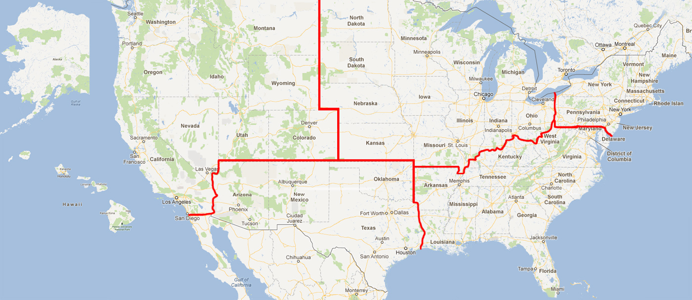

Slide 9
Annual Trend Dollars of RMR*
Region |  | 2017 |  | 2018 |  | 2019
Northeast | $ | 61,334,025 | $ | 61,733,809 | $ | 105,525,041
Southeast | $ | 78,092,485 | $ | 83,800,371 | $ | 202,121,819
Midwest | $ | 62,794,424 | $ | 66,113,540 | $ | 116,843,212
Southwest | $ | 52,275,939 | $ | 57,191,449 | $ | 98,181,551
West | $ | 77,141,809 | $ | 79,871,416 | $ | 136,620,587
International | $ | 34,481,330 | $ | 32,481,077 | $ | 35,047,452
 | $ | 366,120,011 | $ | 381,191,662 | $ | 694,339,662
*Recurring Monthly Revenue

Slide 10
Annual Trend Dollars of RMR*
Size |  | 2017 |  | 2018 |  | 2019
3-50 | $ | 255,041 | $ | 302,197 | $ | 909,695
51-100 | $ | 1,127,048 | $ | 985,066 | $ | 4,422,419
101-200 | $ | 2,406,738 | $ | 1,889,849 | $ | 12,971,670
201-500 | $ | 16,489,623 | $ | 16,968,853 | $ | 32,075,479
500+ | $ | 345,841,561 | $ | 361,045,697 | $ | 643,960,399
Total | $ | 366,120,011 | $ | 381,191,662 | $ | 694,339,662
*Includes branches of companies reflected by RMR size/Attrition if provided

Slide 11
Annual Trend Dollars of RMR
Customer Source |  | 2017 |  | 2018 |  | 2019
Dealer | $ | 63,001,159 | $ | 65,650,799 | $ | 122,954,143
Traditional | $ | 159,469,080 | $ | 162,909,974 | $ | 328,967,274
Mass Market | $ | 143,649,772 | $ | 152,630,889 | $ | 242,418,245
Total | $ | 366,120,011 | $ | 381,191,662 | $ | 694,339,662

Slide 12
Annual Trend Dollars of RMR
Customer Type |  | 2017 |  | 2018 |  | 2019
Residential | $ | 218,645,015 | $ | 230,316,551 | $ | 517,100,871
Commercial | $ | 147,474,997 | $ | 150,875,111 | $ | 177,238,791
Total | $ | 366,120,011 | $ | 381,191,662 | $ | 694,339,662

Slide 13
Attrition Update through Year End 2019
 | 2017 |  | 2018 |  | 2019
Region | Gross | Net | Gross | Net | Gross | Net
Northeast | 12.46% | 10.41% | 13.08% | 11.00% | 12.90% | 11.02%
Southeast | 13.21% | 10.61% | 13.54% | 11.29% | 15.45% | 13.04%
Midwest | 12.61% | 10.32% | 12.88% | 10.86% | 14.62% | 12.90%
Southwest | 14.64% | 12.32% | 14.79% | 12.85% | 16.39% | 14.40%
West | 13.16% | 10.53% | 13.43% | 10.99% | 14.10% | 11.53%
International | 13.55% | 11.31% | 13.86% | 11.91% | 14.87% | 13.28%

Slide 14
Attrition Update through Year End 2019
 | 2017 |  | 2018 |  | 2019
Co. Size | Gross | Net | Gross | Net | Gross | Net
3-50 | 7.67% | 6.30% | 8.18% | 6.65% | 10.96% | 9.27%
51-100 | 9.00% | 7.10% | 9.40% | 7.52% | 16.21% | 13.32%
101-200 | 8.71% | 7.46% | 10.24% | 8.55% | 15.79% | 12.92%
201-500 | 10.48% | 8.74% | 10.66% | 8.93% | 12.79% | 9.82%
500+ | 13.39% | 10.96% | 13.71% | 11.54% | 14.83% | 12.75%

Slide 15
Net Attrition by Company Size
10 Year Profile

Slide 16
Attrition Update through Year End 2019
 | 2017 |  | 2018 |  | 2019
Source | Gross | Net | Gross | Net | Gross | Net
Dealer | 14.37% | 12.54% | 16.06% | 13.95% | 16.38% | 14.06%
Traditional | 12.17% | 9.99% | 12.03% | 9.68% | 14.05% | 11.89%
Mass Market | 13.84% | 10.99% | 14.07% | 12.12% | 14.90% | 12.86%

Slide 17
Net Attrition by Origination Source
10 Year Profile

Slide 18
Attrition Update through Year End 2019
 | 2017 |  | 2018 |  | 2019
Customer Type | Gross | Net | Gross | Net | Gross | Net
Residential | 13.73% | 11.13% | 14.21% | 12.14% | 15.32% | 13.36%
Commercial | 12.43% | 10.36% | 12.52% | 10.25% | 13.13% | 10.44%

Slide 19
Residential vs. Commercial 10 Year Profile

Slide 20
Reason Code Analysis
Cancellation Reason | 2016 | 2017 | 2018 | 2019
Collection/Non-Payment | 14.8% | 11.6% | 11.1% | 14.15%
Moved | 32.5% | 34.1% | 33.8% | 39.04%
Poor Service | 3.3% | 2.5% | 3.3% | 1.85%
Lost to Competition | 14.9% | 12.9% | 13.4% | 9.31%
No Longer Using System | 12.0% | 15.0% | 13.1% | 17.69%
Sold/Out of Business | 4.3% | 8.5% | 9.9% | 4.85%
Financial Difficulties | 8.7% | 4.2% | 4.0% | 4.34%
Property Abandoned/Vacant | 0.1% | 0.2% | 0.1% | 0.01%
End of Contract Term | 0.4% | 0.4% | 0.9% | 0.04%
Deceased/Rest home | 0.5% | 1.2% | 1.1% | 0.11%
PI Rescinded/RMR Reduction | 8.5% | 9.0% | 7.8% | 5.90%
2G/3G Transition | n/a | 0.4% | 1.5% | 2.73%

Slide 21
Top Reasons for Attrition

Slide 22
Net Attrition by Reason Code - Top 5 Reasons

Slide 23
PERS Attrition Profile
Attrition Profile Comparative
 | 2017 | 2018 | 2019
Data Population | 1,707,000 Subscribers | 1,603,000 Subscribers | 1,545,800 Subscribers
Estimated RMR | $42.6M | $39.5M | $38.4M
Annualized Attrition | 32.57% | 31.14% | 29.40%
Monthly Average Attrition | 2.71% | 2.60% | 2.45%
Sources: Published Attrition metrics, company and PERS Central Station interviews and PERS transaction presentations/analysis.

Slide 24
PERS Attrition 2017/18/19 Reasons Comparison
Sources: Published Attrition metrics, company and PERS Central Station interviews and PERS transaction presentations/analysis.

Slide 25
TRG Maintains Full Confidentiality of Participant’s Figures
Summary results as presented will be available on
TMA Web-Site (www.tma.us)
TRG Web-Site (www.trgassociates.com)
Next update for 2020 – August 2021
Posted in September 2021

