Slide 1
Attrition Measurement
Update 2021
Continuing to Develop Meaningful Trends
Prepared By:
TRG Associates, Inc.
860-395-0548
www.trgassociates.com

Slide 2

Due Diligence
Acquisition Planning
Seeking Debt & Equity
Operations Analysis
Business Valuations
Expert Witness
Customer Surveys
Social Media Assessment

Slide 3
Defining Attrition
Gross Attrition
  The loss of existing customers and their associated recurring monthly revenue (RMR) for contracted services during a particular customer/ calendar cycle
Net Attrition
  Gross Attrition plus the add back of “like customer” gains thru resigns of the existing locations –
    The Home/Business location is your ultimate customer
    Price increases for inflation
    Price increases for additional services or technology

Slide 4
Defining Attrition
The Short Version
  The measurement of customer dissatisfaction with or need for the system
Why Measure?
  Attrition measures customer dissatisfaction which, for the most part, is company caused.
  The Attrition Tracking Process should be managed to identify, focus on, and rectify those causes within each organization.

Slide 5
Attrition Measurement Methodology
Weighted Ending RMR Attrition Method
Step 1: Cancelled RMR for the Reporting Period = Monthly Attrition Sum of Ending RMR for Each Month
Step 2: Monthly Attrition (from Step 1)* 12 = Annualized Attrition
An Excel Attrition Measurement Template is available on the TRG website with calculation formulas

Slide 6
Benefits of Weighted Ending RMR
Method
Accounts for and weights RMR acquisitions
Accounts for timing of acquired RMR
Accounts for rapid internal growth and the timing thereof
Similar to many lending/equity institution’s preferred calculation.

Slide 7
The Geography of Attrition
NE/Mid Atlantic
Southeast
Midwest
Southwest
West
International

Slide 8
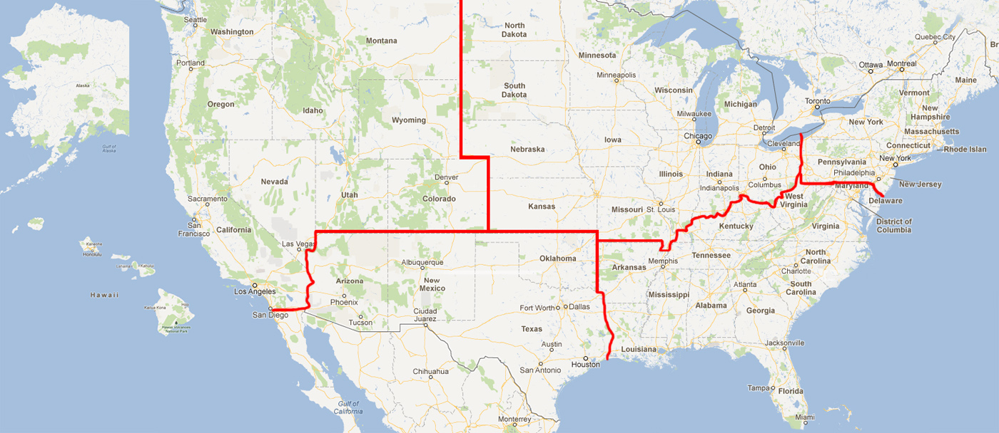

Slide 9
Annual Trend Dollars of RMR*
Region |  | 2019 |  | 2020 |  | 2021
Northeast | $ | 105,525,041 | $ | 107,624,648 | $ | 123,111,156
Southeast | $ | 202,121,819 | $ | 205,684,331 | $ | 224,956,229
Midwest | $ | 116,843,212 | $ | 118,450,840 | $ | 129,069,346
Southwest | $ | 98,181,551 | $ | 99,258,428 | $ | 110,997,455
West | $ | 136,620,587 | $ | 138,915,926 | $ | 153,938,732
International | $ | 35,047,452 | $ | 33,855,680 | $ | 42,050,549
 | $ | 694,339,662 | $ | 703,789,853 | $ | 784,123,467
*Recurring Monthly Revenue

Slide 10
Annual Trend Dollars of RMR*
Size |  | 2019 |  | 2020 |  | 2021
3-50 | $ | 909,695 | $ | 403,929 | $ | 280,051
51-100 | $ | 4,422,419 | $ | 1,316,603 | $ | 1,491,048
101-200 | $ | 12,971,670 | $ | 6,456,098 | $ | 5,519,824
201-500 | $ | 32,075,479 | $ | 22,988,107 | $ | 23,991,954
500+ | $ | 643,960,399 | $ | 672,625,116 | $ | 752,840,591
Total | $ | 694,339,662 | $ | 703,789,853 | $ | 784,123,467
*Includes branches of companies reflected by RMR size/Attrition if provided

Slide 11
Annual Trend Dollars of RMR
Customer Source |  | 2019 |  | 2020 |  | 2021
Dealer | $ | 122,954,143 | $ | 142,345,396 | $ | 198,822,624
Traditional | $ | 328,967,274 | $ | 302,173,068 | $ | 237,422,728
Mass Market | $ | 242,418,245 | $ | 259,271,389 | $ | 347,878,115
Total | $ | 694,339,662 | $ | 703,789,853 | $ | 784,123,467

Slide 12
Annual Trend Dollars of RMR
Customer Type |  | 2019 |  | 2020 |  | 2021
Residential | $ | 517,100,871 | $ | 517,985,056 | $ | 572,848,961
Commercial | $ | 177,238,791 | $ | 185,804,797 | $ | 211,274,506
Total | $ | 694,339,662 | $ | 703,789,853 | $ | 784,123,467

Slide 13
Attrition Update through Year End 2021
 | 2019 |  | 2020 |  | 2021
Region | Gross | Net | Gross | Net | Gross | Net
Northeast | 12.90% | 11.02% | 12.99% | 10.86% | 14.16% | 12.65%
Southeast | 15.45% | 13.04% | 14.35% | 11.66% | 13.67% | 12.39%
Midwest | 14.62% | 12.90% | 13.53% | 11.30% | 12.51% | 11.05%
Southwest | 16.39% | 14.40% | 14.80% | 12.58% | 13.82% | 12.34%
West | 14.10% | 11.53% | 13.67% | 11.22% | 13.03% | 11.44%
International | 14.87% | 13.28% | 15.17% | 13.54% | 12.89% | 11.02%

Slide 14
Attrition Update through Year End 2021
 | 2019 |  | 2020 |  | 2021
Co. Size | Gross | Net | Gross | Net | Gross | Net
3-50 | 10.96% | 9.27% | 12.40% | 11.26% | 14.60% | 13.27%
51-100 | 16.21% | 13.32% | 8.42% | 7.03% | 8.41% | 7.09%
101-200 | 15.79% | 12.92% | 12.24% | 10.78% | 10.20% | 9.74%
201-500 | 12.79% | 9.82% | 9.73% | 8.33% | 9.40% | 8.34%
500+ | 14.83% | 12.75% | 14.15% | 11.70% | 13.57% | 12.10%

Slide 15
Net Attrition by Company Size
10 Year Profile

Slide 16
Attrition Update through Year End 2021
 | 2019 |  | 2020 |  | 2021
Source | Gross | Net | Gross | Net | Gross | Net
Dealer | 16.38% | 14.06% | 15.42% | 12.60% | 15.35% | 14.33%
Traditional | 14.05% | 11.89% | 12.79% | 10.37% | 11.47% | 9.87%
Mass Market | 14.90% | 12.86% | 14.55% | 12.51% | 14.20% | 12.57%

Slide 17
Net Attrition by Origination Source
10 Year Profile

Slide 18
Attrition Update through Year End 2021
 | 2019 |  | 2020 |  | 2021
Customer Type | Gross | Net | Gross | Net | Gross | Net
Residential | 15.32% | 13.36% | 14.58% | 12.12% | 14.40% | 12.95%
Commercial | 13.13% | 10.44% | 12.28% | 10.20% | 11.55% | 10.02%

Slide 19
Residential vs. Commercial
10 Year Profile

Slide 20
Reason Code Analysis
Cancellation Reason | 2018 | 2019 | 2020 | 2021
Collection/Non-Payment | 11.1% | 14.15% | 10.60% | 12.34%
Moved | 33.8% | 39.04% | 33.77% | 40.57%
Poor Service | 3.3% | 1.85% | 2.67% | 3.58%
Lost to Competition | 13.4% | 9.31% | 17.80% | 11.36%
No Longer Using System | 13.1% | 17.69% | 12.84% | 14.97%
Sold/Out of Business | 9.9% | 4.85% | 9.03% | 7.11%
Financial Difficulties | 4.0% | 4.34% | 5.63% | 4.85%
Property Abandoned/Vacant | 0.1% | 0.01% | 0.40% | 0.04%
End of Contract Term | 0.9% | 0.04% | 0.72% | 0.42%
Deceased/Rest home | 1.1% | 0.11% | 0.91% | 0.93%
PI Rescinded/RMR Reduction | 7.8% | 5.90% | 4.55% | 2.12%
2G/3G Transition | 1.5% | 2.73% | 0.74% | 1.71%

Slide 21
Top Reasons for Attrition

Slide 22
Net Attrition by Reason Code - Top 5 Reasons

Slide 23
Attrition Comparison 500+ Co Size 2009/10 – 20/21
 | 2009 |  | 2010 |  | 2020 |  | 2021
Co. Size | Gross | Net | Gross | Net | Gross | Net | Gross | Net
500+ | 11.74% | 9.09% | 11.41% | 8.68% | 14.15% | 11.70% | 13.57% | 12.1%
RMR | $120,944,419 |  | $137,082,802 |  | $672,625,116 |  | $752,840,591

Slide 24
Attrition Analytics
Provides data and focus:
  By Branch
  Service Issues
  Central Station Issues
  By Product Utilization Issues
  Attrition Predictive Analytics
  Analysis of Customer Touches - Email, Phone Contacts, Payment history, Signal activity
  Complaint's analysis and NPS score
  Assign values to customer characteristics and weight each
  Arrive at an Attrition Predictive Index (API)
  Develop a Corrective Action plan by API Index
    Cancel Pending
    Probable Cancel Pending
    Watch List

Slide 25
PERS Attrition Profile
Attrition Profile Comparative
 | 2019 | 2020 | 2021
Data Population | 1,545,800 Subscribers | 2,172,000 Subscribers | 1,947,500 Subscribers
Estimated RMR | $38.4M | $64.4M | $51.2M
Annualized Attrition | 29.40% | 28.58% | 29.90%
Monthly Average Attrition | 2.45% | 2.38% | 2.49%
Sources: Published Attrition metrics, company and PERS Central Station interviews and PERS transaction presentations/analysis.

Slide 26
PERS Attrition Reasons Comparison
Sources: Published Attrition metrics, company and PERS Central Station interviews and PERS transaction presentations/analysis.

Slide 27
Attrition Best Practices Gathering

Slide 28
TRG Maintains Full Confidentiality of Participant’s Figures
Summary results as presented will be available on
TMA Web-Site (www.tma.us)
TRG Web-Site (www.trgassociates.com)
Next update for 2022 – August 2023
Posted in September 2023

